Slide 1
Installation Guide
(WAS – Jeus 6.0.0.5)
2009. 07. 21
CODELABOR
Shin Sang Jae (codelabor@gmail.com)

Slide 2

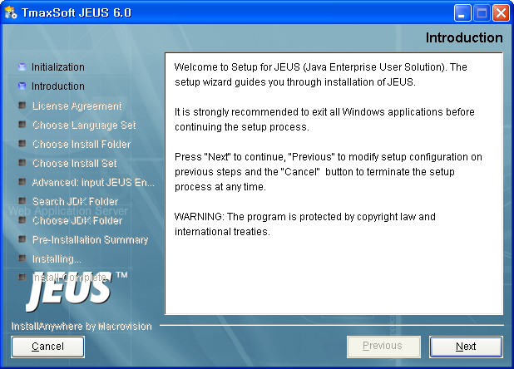
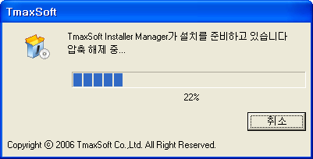
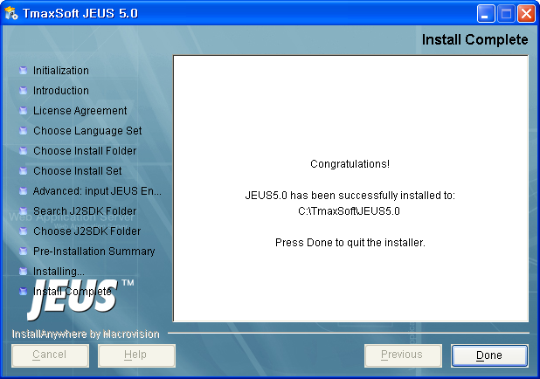
WAS
Install
File: jeus60-win-en.exe
Install directory: C:\TmaxSoft\JEUS6.0

Slide 3
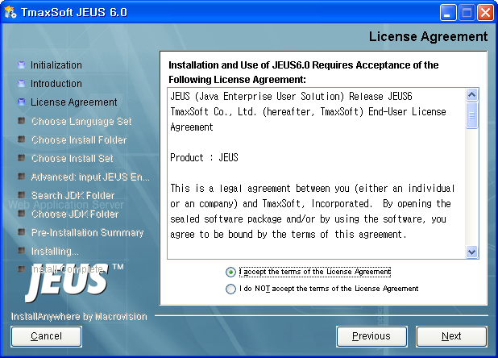
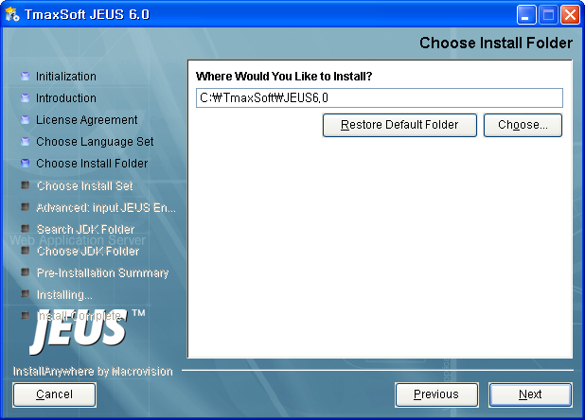
WAS
Install
Install Folder: C:\TmaxSoft\JEUS6.0

Slide 4
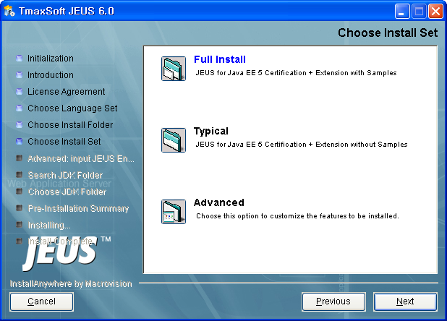
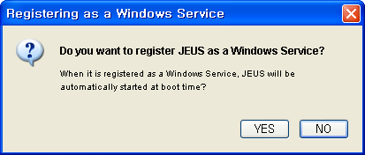
WAS
Install
Install Set: Full Install
Register JEUS as a Windows Service: No

Slide 5
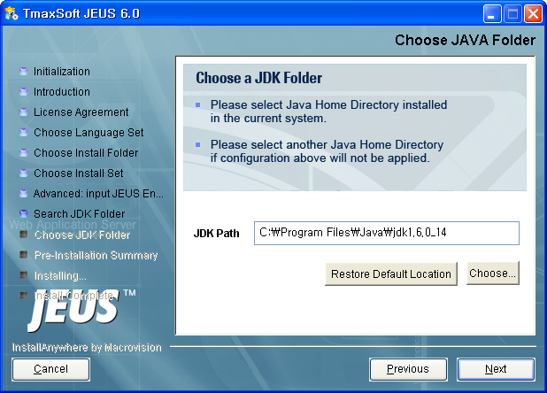
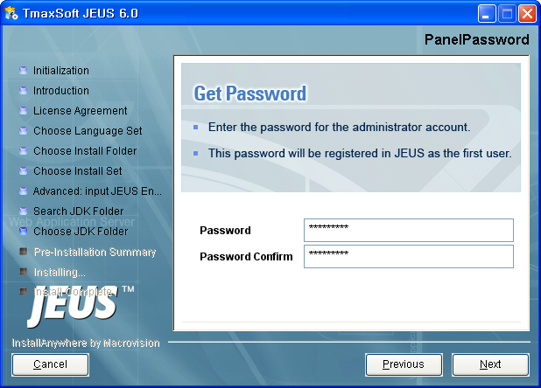
WAS
Install
JDK Path: C:\Program Files\Java\jdk1.6.0_11
Password: jeusadmin

Slide 6
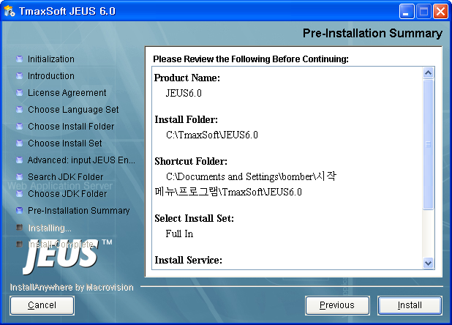
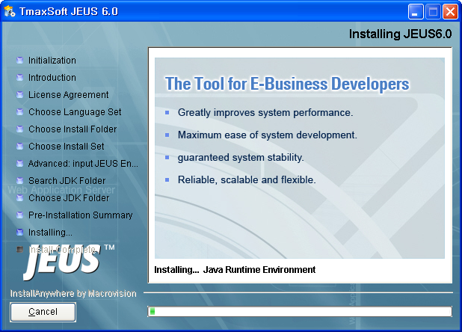
WAS
Install

Slide 7
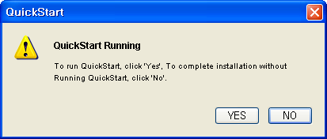
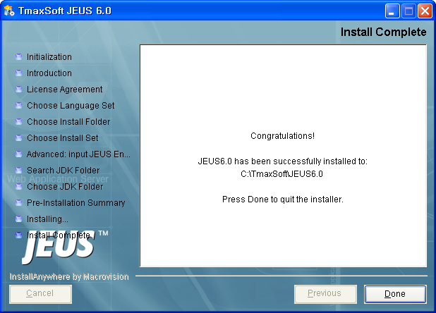
WAS
Install
QuickStart Running: No

Slide 8
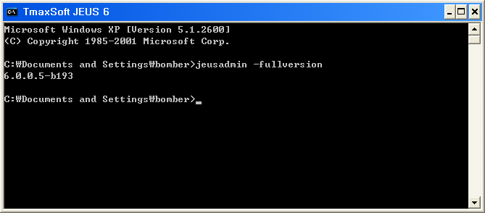
WAS
Version
Check Version: jeusadmin -fullversion

